Slide 1
Welcome to Germany – good things to know! Tips, details & guidelines for the students of DIU
Dresden
01.11.2022

Slide 2
The German health care system
1.

Slide 3
The German health care system The principle of solidarity
The principle of solidarity is the foundation upon which social health insurance rests.
The social security contribution assessment of your health cover is solely based on your individual financial situation and not on personal health risks or other factors.
This is the most important and vital principle of social safeguarding in the event of illness: the costs for all health risks that are mandatorily covered by the insurance are distributed equally among all insurees.
The young pay for the old
The healthy for the sick
Solidarity
The rich for the poor

Slide 4
The German health care system Social and private health insurance
What kind of insurance covers do Germans have?
Social Health Insurance (SHI)
Within SHI, the principle of solidarity applies. All members are entitled to the same benefits, regardless of their income and of how much they pay in contributions.
In this respect, TK operates cost-covering and does not make a profit.
Private Health Insurance (PHI)
Customers insure their personal risk taking individually. This means the more you are prepared to pay, the better you are covered in a emergency.
In this respect, the goals of PHI are to make a profit.
Source: Association of Health Insurance Funds / www.vdek.com 12/2018

Slide 5
The German health care system The benefits of social health insurance
Medical treatment
Dental treatment
Treatment in hospital and hospitalisation
Sick pay
Medicines, medical equipment, and other remedies
Treatment at a health spa
Important medical check-ups & courses in preventive care
and much more…

Slide 6
The German health care system Monthly contribution for TK-health insurance (2022)
For students with children or | 82,99 Euros health insurance
under 23 years of age: | + 24,77 Euros long-term care insurance
 | + 9,74 Euros TK-specific amount
 | = 117,50 Euros monthly
For students without children and | 82,99 Euros health insurance
above 23 years of age: | + 27,61 Euros long-term care insurance
 | + 9,74 Euro TK-specific amount
 | = 120,34 Euros monthly
After the age of 30:
Contributions for voluntary insurance cover
For members with children: |  | 200,14 Euros monthly
For members without children: |  | 202,88 Euros monthly

Slide 7
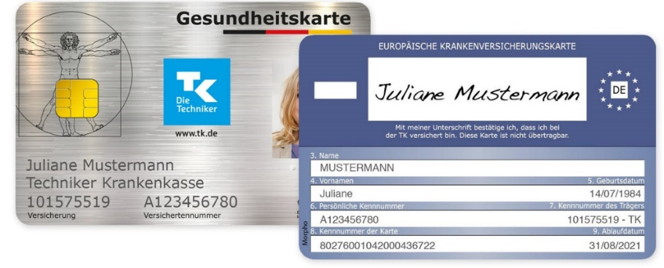
The German health care system The health card
The electronic health card is issued to every member of a social health insurance fund
A passport photo clearly identifies the insuree. The card should always be carried
The health card is needed whenever you see a doctor or go to the hospital
The fees are directly settled via the card

Slide 8
Cost Participation
A federally mandated co-payment is required for a few services, such as:
Medicines (5-10 EUR)
Hospitalisation (10 EUR per day for a maximum of 28 days)
Rehabilitation measures (10 EUR per day for a maximum of 28 days)
Therapy and aids (5-10 EUR)
Dental Treatment

Slide 9
Techniker Krankenkasse (TK)
2.

Slide 10
Techniker Krankenkasse (TK) TK‘s strengths
We speak your language!
In addition to German, many of our employees also speak other languages, such as English, French, Italian, Spanish, Russian, Turkish, etc. (040 - 46 06 02 53 00)
We understand you best!
TK has the largest number of academics and the highest market share in students.
We do our best!
Numerous institutions and organisations honour us every year, among them Focus Money – for the fourteen time in succession, the magazine chose us as Germany‘s best health insurance fund.

Slide 11
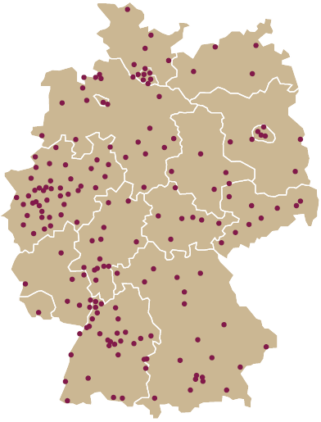
Techniker Krankenkasse (TK) TK‘s strengths
Your TK-ServiceTeam
Consultation around the clock by phone, 365 days a year.
Personal Consultation
In about 200 offices throughout Germany, even in your home, if requested.
tk.de
You will find numerous informations about our services and benefits. Also the exclusiv customer access „My TK“.
TK-App
Download the TK Application to contact the TK and or manage your bonus program

Slide 12
At the onset of your studies – essential documents
3.

Slide 13
At the onset of your studies Essential documents
Before you can begin with your studies, you must complete four tasks in advance:
Registration Confirmation
(Bank Account)
Health Insurance
Enrolment
Since these individual steps are contingent upon one another, it is best to take care of them in the following order:
Registration confirmation
1
(Bank Account)
Health Insurance
Enrolment
4

Slide 14
First days in germany What to do next?
New since this year: DIU needs a digital insurance notification for the start of your semester
If you already registerd via Expatrio, please provide them with your german address
Contact me via olfo.papst@tk.de if you need help
Provide TK with imatriculation certificate

Slide 15
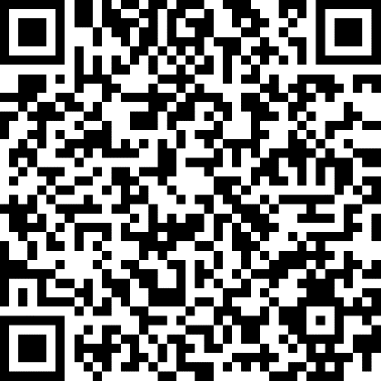
If you have questions….
Olfo Pabst
Techniker Krankenkasse
olfo.pabst@tk.de
…please contact me.

